Slide 1

Lecture 6: Markov Decision Process I
Monday 6:30-9:00
EAS 230

Slide 2
How to Solve AI Tasks?
Lecture 2&3
Lecture 4-7
Lecture 8-9
Lecture 10-13
Search problems
Bayes Networks
Logic
MDP
Deep learning
State-based models
Variable-based models
“Virtual Assistant”
Reflex
"low level AI"
"high level AI"
Handles complicated logics
Reflex
Reflex
Machine learning
Notes:
still will continue the reflex based model

Slide 3
Overview of Lecture 6
Overview
Markov Decision Process
Policy Iteration
Value Iteration
Reflex
Reflex
Machine learning

Slide 4
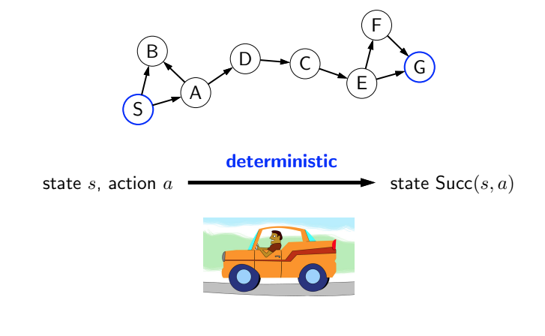
Search: Deterministic transition
2
1
5
3
2
2
3
7
1
Notes:
so far we talked about search problem, where the successor of a state following an action is deterministic

Slide 5
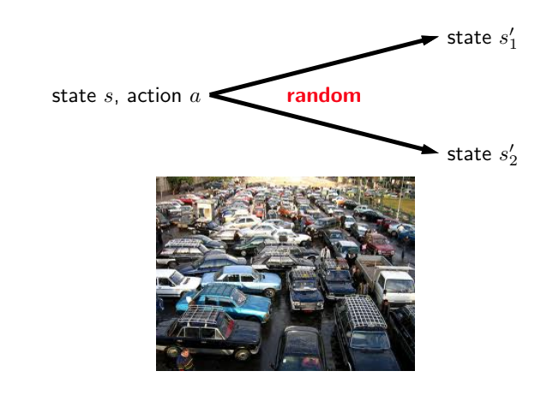
Reality: Non-deterministic transition
Notes:
in reality, taking the same action may result in multiple different states
one question is how can we even hope to act optimally? in a world of randomness, we can’t stick to a deterministic plan
we will develop tools to solve this more challenging setting

Slide 6
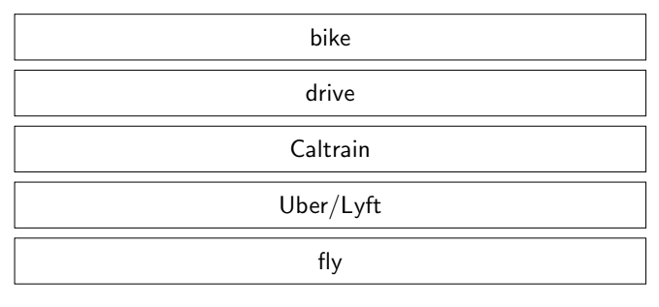
Question
What is the fastest way to travel from Gateway South to Times Square on a Friday night?
walk
train
bus
drive
Notes:
my friend came to visit me and stuck in the traffic

Slide 7
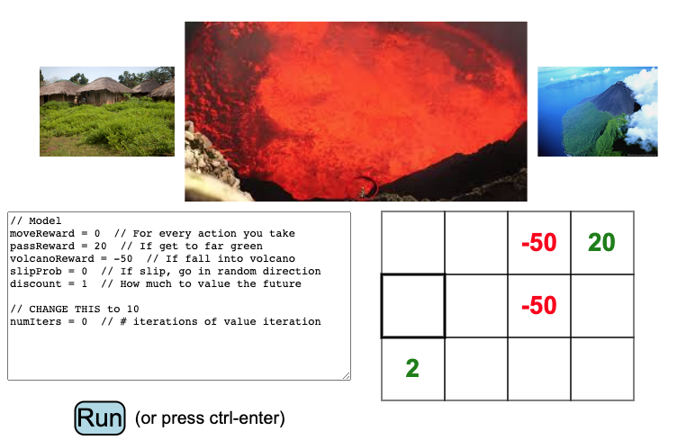
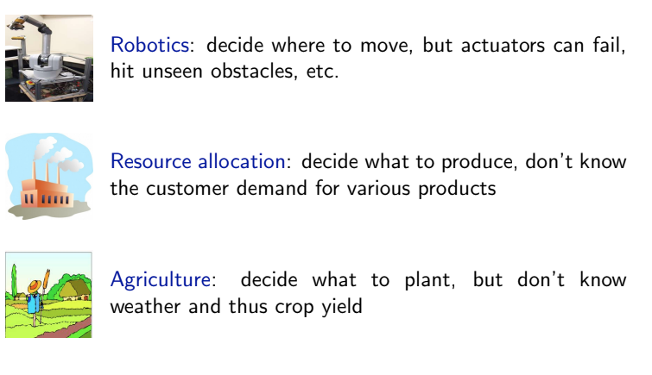
Example 1: Volcano crossing
Notes:
I’m starting from this, can move to all the 4 directions. Should I cross the mountain?

Slide 8
Example 1: Volcano crossing
20
20
20
20
20
20
20
20
value: 20
Notes:
I’m starting from this, can move to all the 4 directions.
case 1: if moving has no cost, slip prob = 0, Should I cross the mountain?
but the thing is we’ve been talking about how the world is stochastic and slip prob may not be 0

Slide 9
Example 1: Volcano crossing
20
20
0.1
20
20
20
20
20
20
value: 20
Notes:
if the chance of falling is 10%, how many people would still cross?

Slide 10
Example 1: Volcano crossing
13.4
12.3
0.1
13.7
14.1
18.2
15.9
16.3
18.1
value: 13.7
Notes:
the optimal solution is shown by the arrow, and the optimal solution is still to cross
the value is the expected utility you will get, we’ll talk about it later

Slide 11
Example 1: Volcano crossing
13.4
12.3
0.2
13.7
14.1
18.2
15.9
16.3
18.1
value: 13.7
Notes:
how many people would cross at 20%?

Slide 12
Example 1: Volcano crossing
6.4
4.3
0.2
7.1
7.6
16.1
11.4
12.2
15.9
value: 7.07
Notes:
the optimal solution is still to cross

Slide 13
Example 1: Volcano crossing
6.4
4.3
0.3
7.1
7.6
16.1
11.4
12.2
15.9
value: 7.07
Notes:
how many people would cross at 30%?

Slide 14
Example 1: Volcano crossing
1.4
2.9
0.3
1.9
1.1
13.8
6.5
7.5
13.2
value: 1.86
Notes:
how many people would cross at 30%?

Slide 15
Overview of Lecture 6
Overview
Markov Decision Process
Policy Iteration
Value Iteration
Reflex
Reflex
Machine learning
Notes:
that was an example of the mdp
we will model these and study how to do inference, which is called value iteration.
in the middle will talk about policy iteration which is not the inference but a step towards it. If someone tells me a policy, can I eveluate how good it is

Slide 16
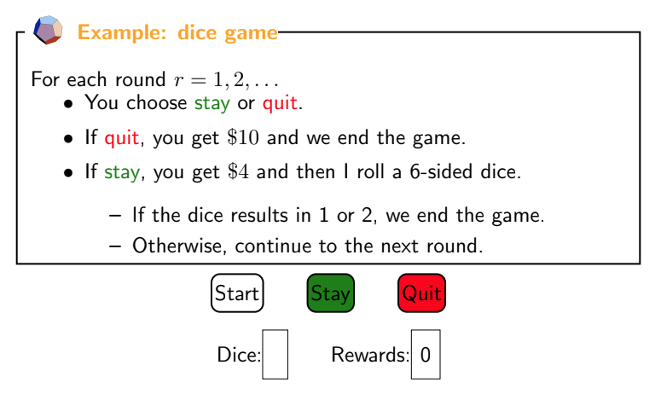
Example 2: Dice game
Reflex
Reflex
Machine learning

Slide 17
Example 2: Dice game
10
Reflex
Reflex
Machine learning

Slide 18
Example 2: Dice game
6
4
Reflex
Reflex
Machine learning

Slide 19
Example 2: Dice game
2
8
Reflex
Reflex
Machine learning

Slide 20
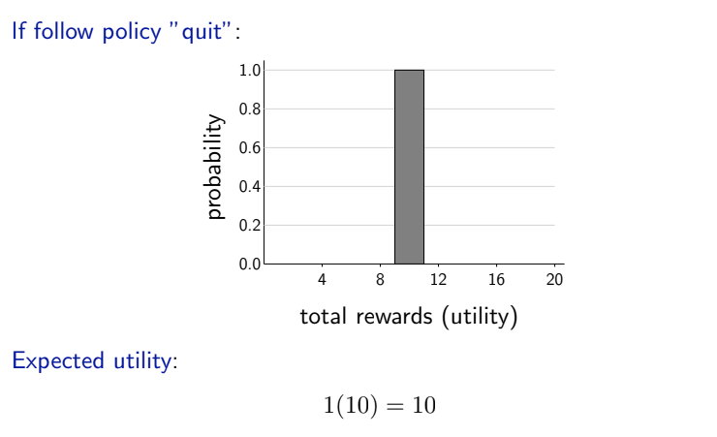
Reward probability distribution
Reflex
Reflex
Machine learning
Notes:
if you decide to quit, this is your expected utility

Slide 21
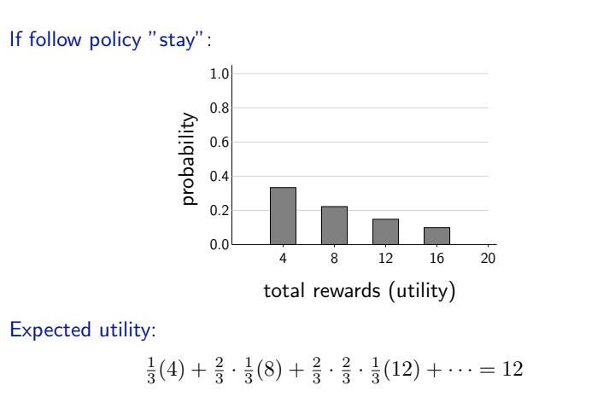
Reward probability distribution
Reflex
Reflex
Machine learning
Notes:
if the policy is keep staying, this is the expected utility, the probability is going to come down
the thing we care about is the expected utility. The expectation is 12

Slide 22
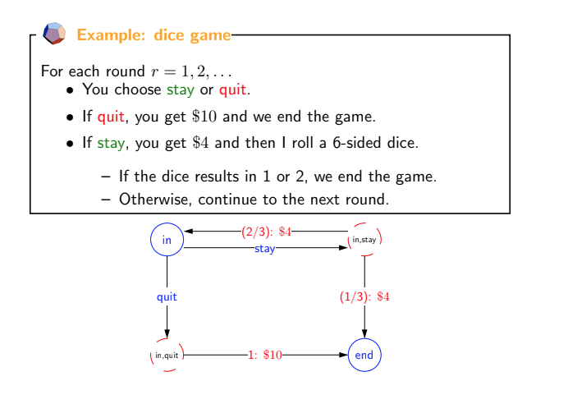
Formalize the dice game as MDP
Reflex
Reflex
Machine learning
Notes:
I want to formalize this problem (draw on the white board)
either in the game or out of the game, these are my states
when I’m in either of these states I can take actions. If I’m in the in state I can decide to stay or I can quit. If I decide to stay that takes me to the chance node. A chance node is a node that represents my state and actions, as a way of going through these examples to see where things are going
in, state nodes -> stay, quit edge -> 1:$10 (deterministic) -> (⅔) 4$, ¼ 4$

Slide 23
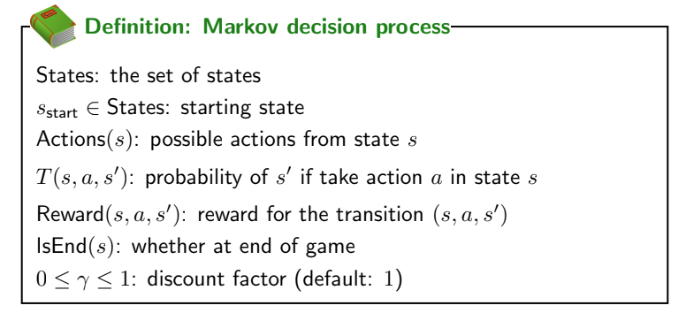
Formalize MDP
Reflex
Reflex
Machine learning
Notes:
more formally, we define the things of MDP here
we have a set of states, in and end
actions, of in, are stay or quit
transition probabilities, take s, a, and the new state s’ and tell me what’s the transition probability T(in, stay, in) = 2/3, T(in, stay, end) = 1/3
reward,
end
in addition there’s the discount factor, I’ll talk about this later don’t worry about it now

Slide 24
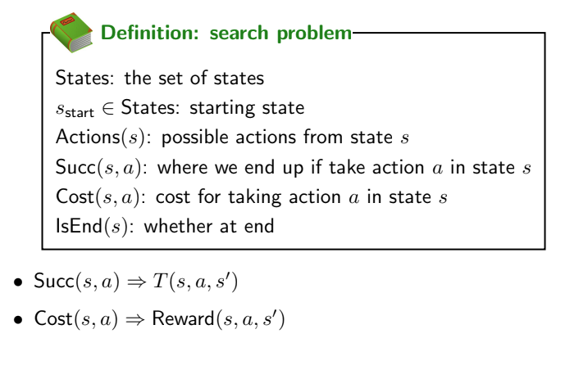
Formalize MDP
Reflex
Reflex
Machine learning
Notes:
the main things that are changed are …

Slide 25
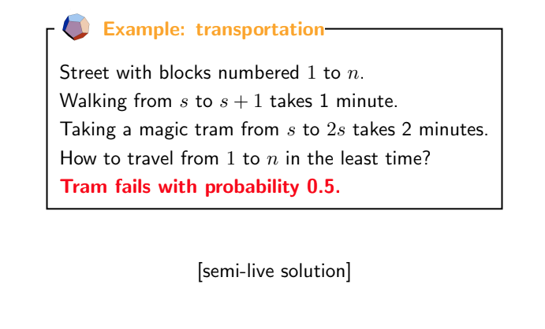
Tram problem with uncertainty
Reflex
Reflex
Machine learning
Notes:
let’s take another problem, which is the tram problem.
tram may be fail maybe not
similar for search problem except we have probabilities

Slide 26
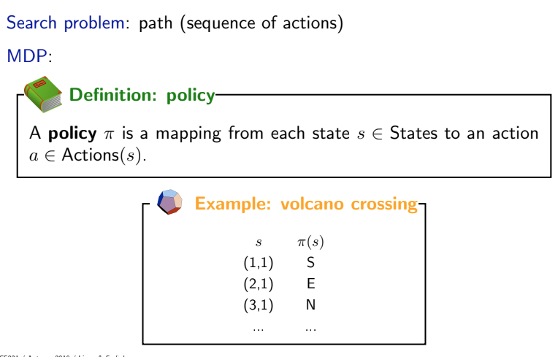
What is a solution?
Notes:
an interesting question is what’s the optimal path
a solution to the search problem was a sequence of actions, because everything is deterministic
but in case of mdp, things are non deterministic, so if you apply a fixed sequence of actions, the agent might end up in a state other than our expectation, so the fixed policy is no longer optimal. For example, if you take the train from lieb building to times square
to provide a solution for the uncertain situation what we need is not a static sequence of actions, but rather a function that tells that at each state, what’s the best action to do, so the solution is dynamic
in the case of volcano crossing, this solution defines the best action for every state. For search, I’ll just say go south and then go east,...

Slide 27
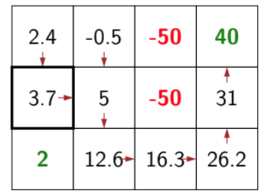
What is a solution?
(1,1) -> S (2,1) -> E (3,1) …
(1,2) -> S (2,2) -> S (3,2) -> E
(1,3) … (2,3) … (3,3) -> E
(1,4) … (2,4) -> N (3,4) -> N
Notes:
an interesting question is what’s the optimal path
a solution to the search problem was a sequence of actions, because everything is deterministic
but in case of mdp, things are non deterministic, so if you apply a fixed sequence of actions, the agent might end up in a state other than our expectation, so the fixed policy is no longer optimal. For example, if you take the train from lieb building to times square
to provide a solution for the uncertain situation what we need is not a static sequence of actions, but rather a function that tells that at each state, what’s the best action to do, so the solution is dynamic
in the case of volcano crossing, this solution defines the best action for every state. For search, I’ll just say go south and then go east,...

Slide 28
Overview of Lecture 6
Overview
Markov Decision Process
Policy Iteration
Value Iteration
Reflex
Reflex
Machine learning
Notes:
next I’ll talk about how we evaluate a policy

Slide 29
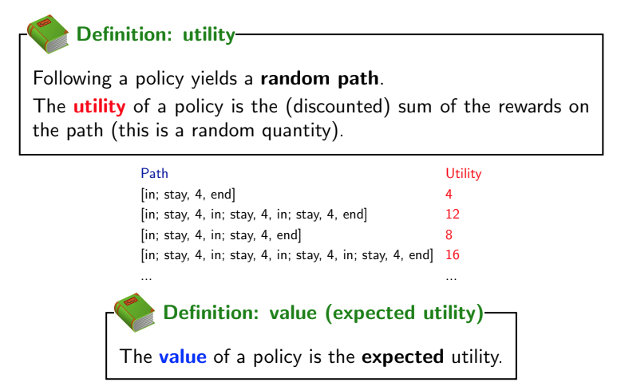
Evaluating a policy
Notes:
if you give me a policy, which tells me at every state s, the policy will generate multiple random paths because the nature behaves differently
for each of those random paths I can define a utility, which is the sum of the reward I get across the path, it can be discounted
the value is defined as the expected utility of a policy. The policy is defined w.r.t a state, so is the value

Slide 30
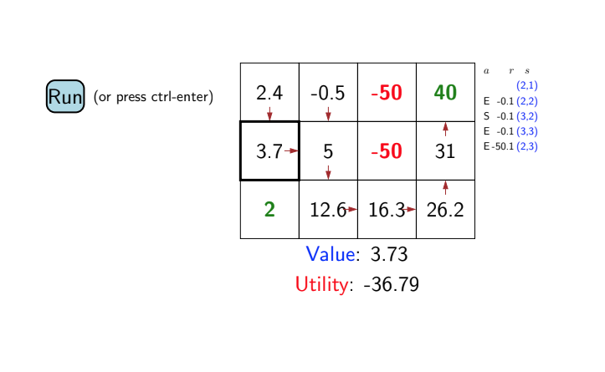
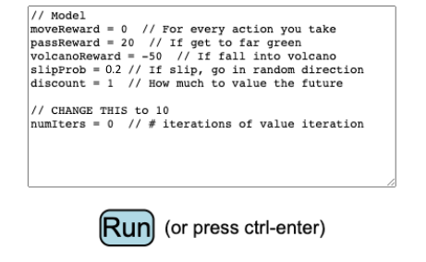
Evaluating a policy: volcano crossing
-0.1
-40
0.3
0.9
Notes:
can run this game, every time i run it, I will get a different utility. some of these paths get into the volcano
the value is not changing

Slide 31
Evaluating a policy: volcano crossing
-0.1
-40
(2,1)
E -0.1 (2,2)
S -50.1 (2,3)
0.3
0.9
Utility: -45.19
Notes:
I’m gonna get a different utility
value is the number associated with this state and it tells me the expected utility if I follow a specific policy

Slide 32
Evaluating a policy: volcano crossing
-0.1
-40
(2,1)
E -0.1 (2,2)
S -0.1 (3,2)
E -0.1 (3,3)
E -0.1 (3,4)
N -0.1 (2,4)
N 39.9 (1,4)
0.3
0.9
Utility: 23.5

Slide 33
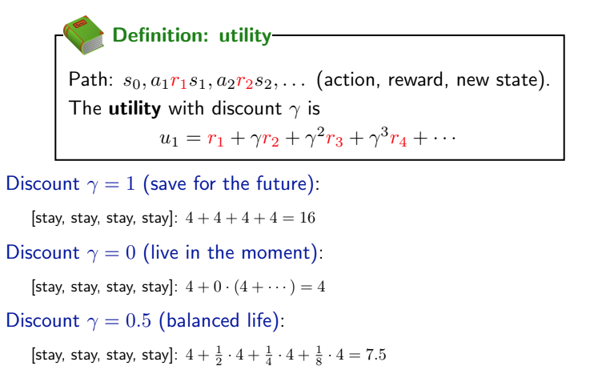
Discounting
Notes:
do I care about the future that much?
for a lot of problems we’ll just use discount factor of 1

Slide 34
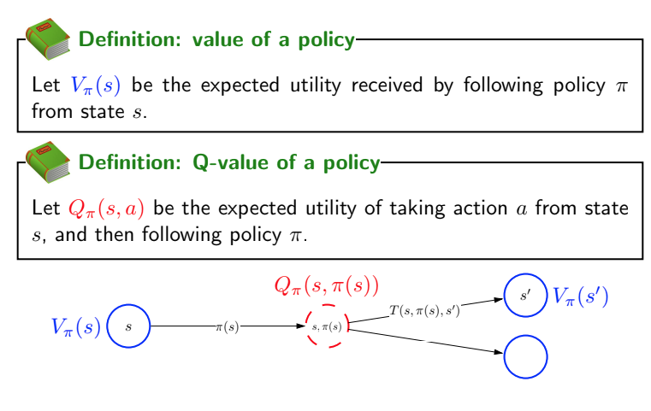
Policy evaluation
Notes:
we’ve been talking about someone give me a policy pi, and we want to figure out what’s the value of pi
v pi is the expected utility received by following pi
Q-value of a policy Qπ(s, a).

Slide 35
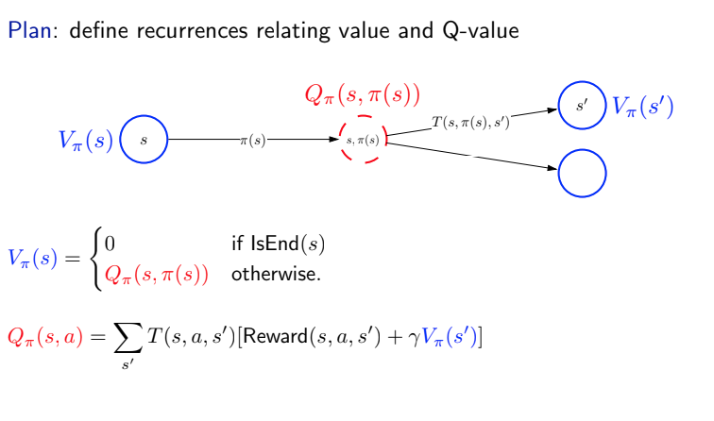
Policy evaluation
Expected utility if starting from s, take action a and then follow pi
Notes:
the sum over all the possible states I can end of the transition probability times the immediate reward plus the value here but I care about the discount
notice the point is this is a recursive definition, this can be proved following the discounting function

Slide 36
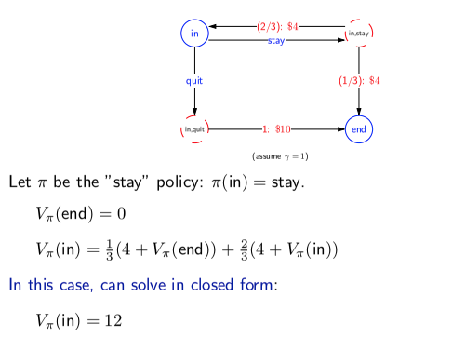
Dice game example
Notes:
when you doing policy evaluation you got to compute vpi for all states
in this specific case we have a closed form solution

Slide 37
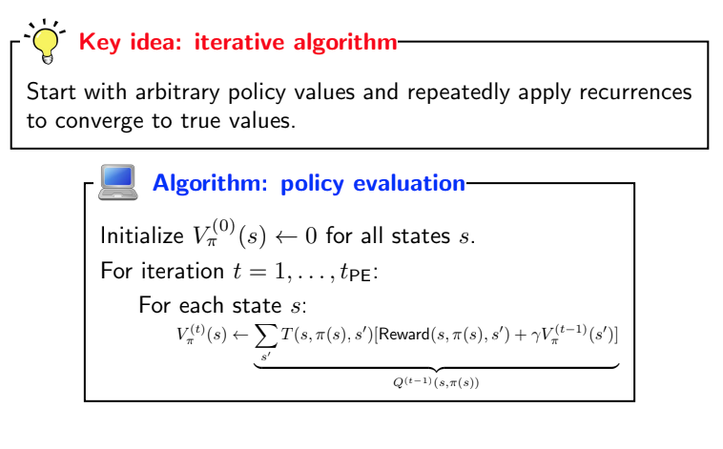
Policy evaluation
Notes:
here it leverages the future state of the previous iteration

Slide 38
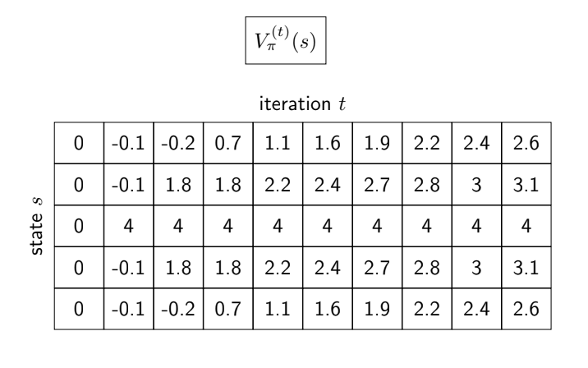
Policy evaluation computation
Notes:
as we can see it converges in the last two iterations

Slide 39
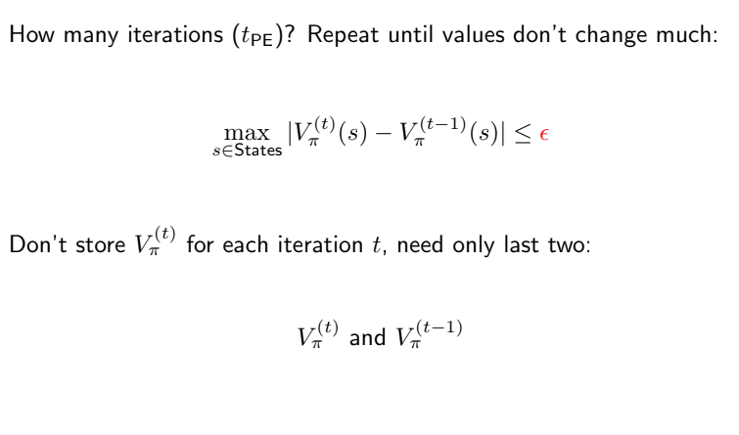
Policy evaluation implementation
Notes:
how long should you run this? one thing is to keep track of the difference of the previous time step with the current time step
another thing is I’m not storing the whole table

Slide 40
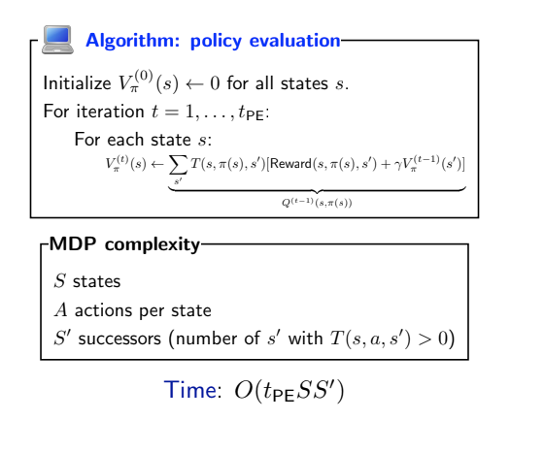
Complexity
Notes:
the reason it doesn’t depends on the size of the action is because I’m given the policy

Slide 41
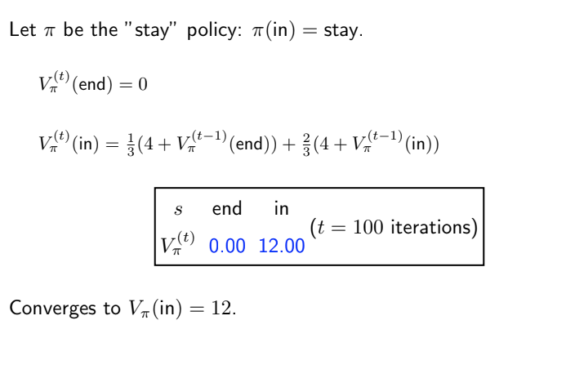
Policy evaluation on dice game
1
4.00

Slide 42
Policy evaluation on dice game
2
6.67

Slide 43
Policy evaluation on dice game

Slide 44
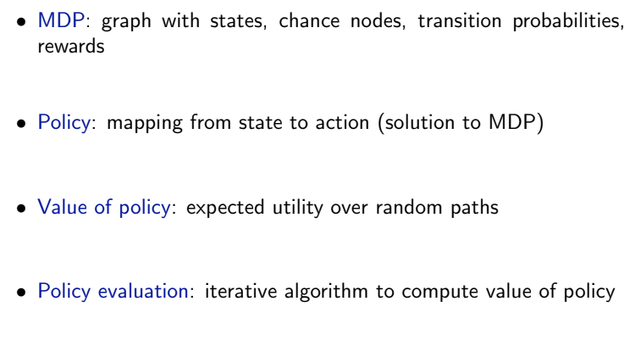
Summary so far

Slide 45
Overview of Lecture 6
Overview
Markov Decision Process
Policy Iteration
Value Iteration
Reflex
Reflex
Machine learning
Notes:
next I’ll talk about how we evaluate a policy

Slide 46
Can policy iteration solve the inference problem?
(1,1) -> S (2,1) -> E (3,1) …
(1,2) -> S (2,2) -> S (3,2) -> E
(1,3) … (2,3) … (3,3) -> E
(1,4) … (2,4) -> N (3,4) -> N
Notes:
policy iteration can only estimated the expected utility by following a specific policy
and if you have a different strategies, you can …
and if we want to use policy iteration to solve the inference problem, but there are exponential number of strategies,
We will now introduce value iteration, which is an algorithm for finding the best policy, which is just very similar to policy iteration

Slide 47
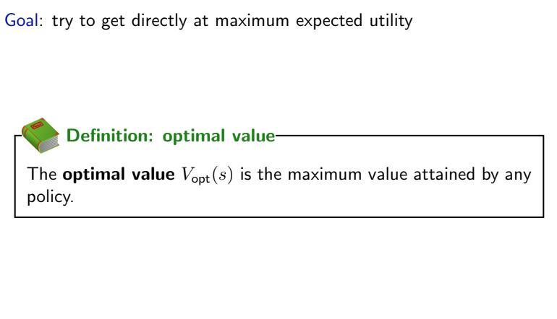
Optimal value and policy
Notes:
now goal is to get the maximum expected utility, and find the set of policy that gets me the maximum expected utility
to do that I need to define a thing called the optimal value, instead of the value of a particular policy, I just want the opt of state s,

Slide 48
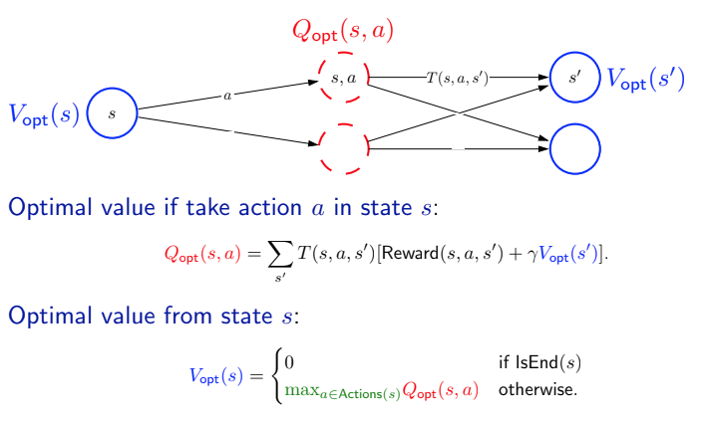
Optimal values and Q-values
Notes:
the difference is before someone told me what the policy is, I just took the q of that
now I take the optimal policy
what’s the optimal policy?

Slide 49
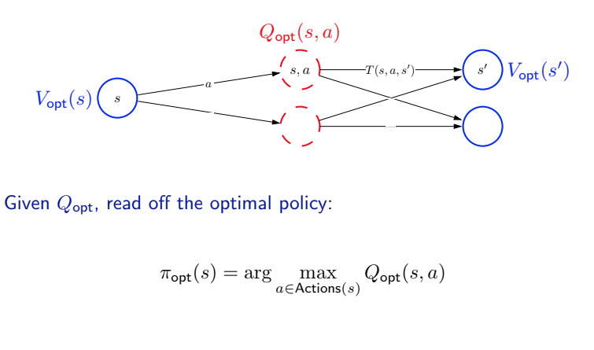
Optimal policy

Slide 50
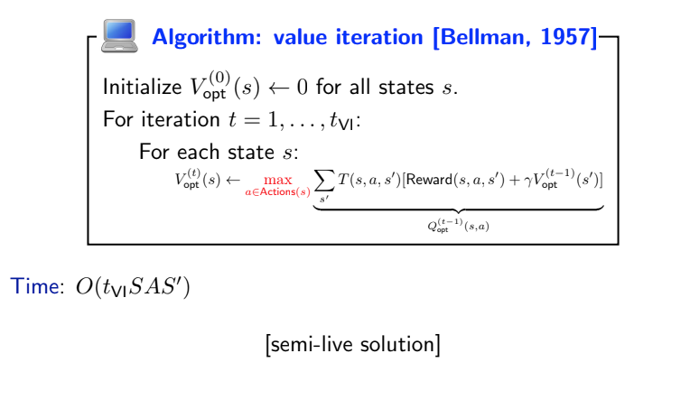
Value iteration: Solving the inference problem

Slide 51
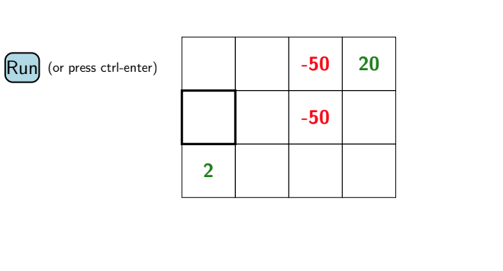
Value iteration: Solving the inference problem
0
-1.2
0.1
1
1.9
1.2
17.3
1.9
1.2
0
value: 1.85
Notes:
with 1 iteration, it hasn’t seen it yet, so the value is 1.85, hasn’t been updated

Slide 52
Value iteration: Solving the inference problem
1.8
0.3
0.1
3
2
0.5
18.1
1.9
13.5
17.2
value: 1.95

Slide 53
Value iteration: Solving the inference problem
13.4
12.3
0.1
10
13.7
14.1
18.2
15.9
16.3
18.1
value: 13.68

Slide 54
Value iteration: Solving the inference problem
13.7
12.4
0.1
100
13.8
14.1
18.2
15.9
16.3
18.1
value: 13.78

Slide 55
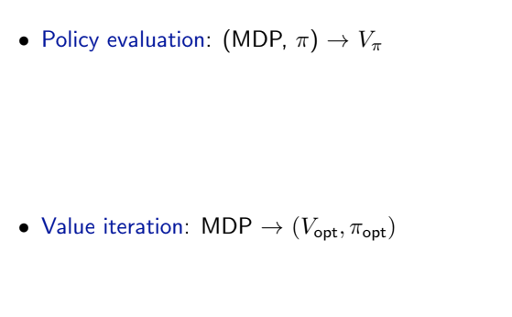
Summary of algorithms

Slide 56
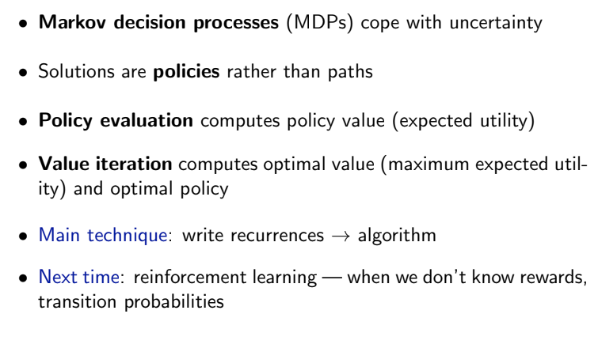
Summaries

